Slide 1
The Neighborhood Battle
Ishika Biswas
IBM Data Science Professional Certification
Capstone Project

Slide 2
Introduction
Real estate business is booming day be day. One of the most challenging scenario is knowing which locality would interest people to settle down, to fore see the future where will people plan to buy their houses.
This project takes a glimpse at different neighborhoods of Toronto, Canada and compares different parameters, such as amenities, house prices, school availability to look for a favorable neighborhood.
This case study will be of great use to real estate companies looking for opportunities for their next project as well as for any new bird to the city looking for a place of their own.

Slide 3
Data Gathering
The very essence of the project is all the data that are being used here are open source
Wikipedia has been used for web scrapping and consolidating the pin code, borough and neighborhood details
For maps and location references Foursquare and Geo API has been used

Slide 4
Methodology
Foursquare API – to retrieve all venues of each neighborhoods, then group by each neighborhoods and to count how many venues before filter top 10 most common venue types of each neighborhoods
K means Clustering – to cluster neighborhood into different groups
Matplotlib - for Exploratory data analysis

Slide 5
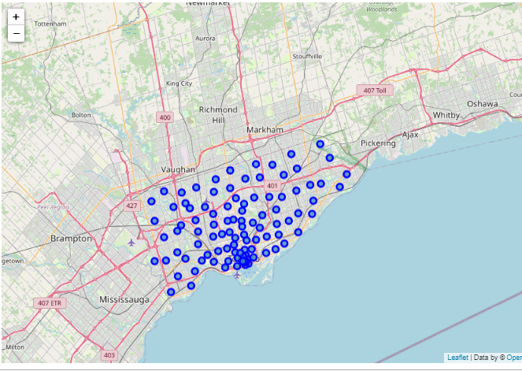
Exploratory Data Analysis
We started exploring by plotting different business hotspots for Scarborough using Foursquare API.

Slide 6
Exploratory Data Analysis
Next step was to categorize the spots as per their business genre. For example, Shopping Mall, Pharmacy, Skating Rink , Restaurant, Coffee Shop, Pizza Place, Pub, Convenience Store etc
Also, there were subcategories for example in Restaurants sections there were Afghan, Thai, Chinese, Mughlai etc.
The data then merged based on latitude/longitude for each neighborhood and categorized based on types using K-mean types and cluster labels were assigned

Slide 7
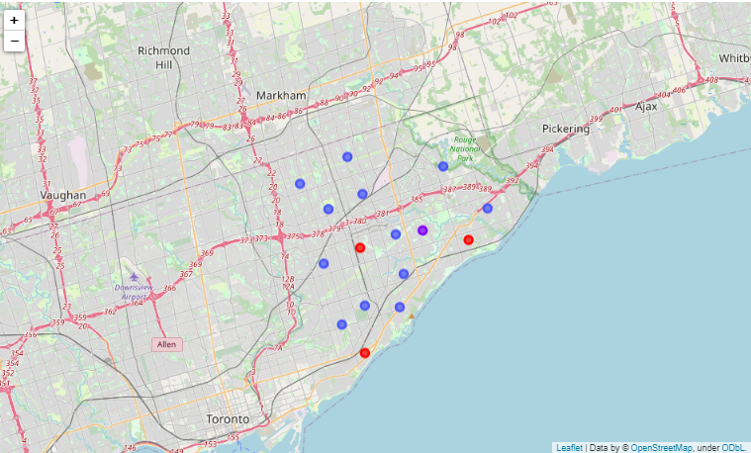
Exploratory Data Analysis
Then these cluster labels were plotted to represent the congregation of business .

Slide 8
Exploratory Data Analysis
Along with plotting maps for business hotspots next in line was to verify other key factors for a rich neighborhood
Average housing price and school ratings were collected.
The data was then plotted in bar graphs to have a comparative visual study.
Next slide slows the details

Slide 9
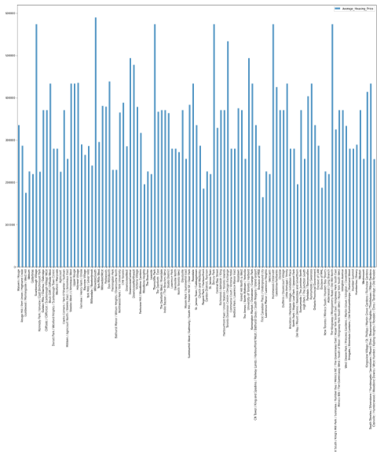
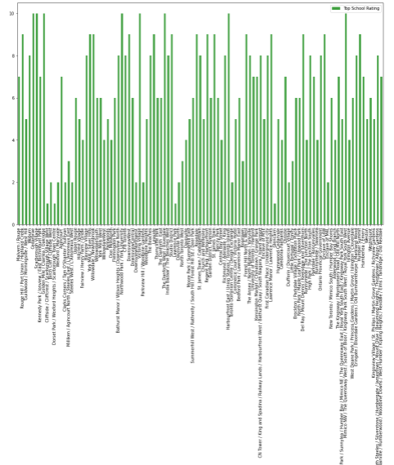
Exploratory Data Analysis
Average Housing price
Average School Rating

Slide 10
Results
Providence has more venues than Hartford (512 vs 460)
Federal Hill has the most venues in Providence
Downtown has the most venues in Hartford
Most of venues in Federal Hill are restaurants, bars
Venues in Downtown Hartford are more diverse includes banks, concert hall, gyms…
Bars, Restaurants, Bakeries, and Diners are very common in Providence
Hartford is more about commercial

Slide 11
Conclusion
For People moving to the city
Providence may be more suitable to spend a good amount time of enjoy the local food
Hartford has less food but more commercial complexes
For business owners/real estate:
Providence is good place to open small business related to food and travel industry
Hartford is better place to involve in insurance industry and hence a good option for new real estate projects

Slide 12
Thank you

